Slide 1
Carry Lookahead Adder

Slide 2
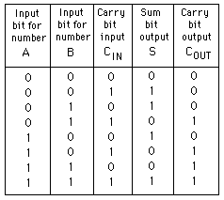

Slide 3
A3
A2
A1
A0
B3
B2
B1
B0
A
B
A
B
A
B
C0
A
B
C3
C2
C1
Cin
Cout
Cin
Cout
Cin
Cout
Cin
Cout
Cin
S
S
S
S
S3
S2
S1
S0

Slide 4
Compute 0101b + 0111b
0
1
0
1
0
1
1
1
A
B
A
B
A
B
A
B
0
1
1
1
0
Cout
Cin
Cout
Cin
Cout
Cin
Cout
Cin
S
S
S
S
S3
S2
S1
S0

Slide 5
0
1
0
1
0
1
1
1
Adder 3
Adder 2
Adder 1
Adder 0
0
I don’t want to wait! Looks like Adder2 can have its carry figured out immediately!

Slide 6
0
1
0
1
0
1
1
1
Adder 3
Adder 2
Adder 1
Adder 0
0
Sure, Adder3, I have both inputs as 1, so I will carry 1 for you no matter what Adder 1 says. BTW, Adder 1, what is your carry?

Slide 7
0
1
0
1
0
1
1
1
Adder 3
Adder 2
Adder 1
Adder 0
0
Adder2, don’t look at me, ask Adder0 instead. I’m adding 0 and 1, so I’ll carry whatever Adder 0 carries.

Slide 8
What does that imply?
“Sure, Adder3, I have both inputs as 1, so I will carry 1 for you no matter what Adder 1 says.”
An adder can generate carry if both its input are 1s. This property cuts the long-chained carry dependency into pieces.
We call it a “Generate” signal. G in short.
G = A and B

Slide 9
What does that imply?
- “Adder2, don’t look at me, ask Adder0 instead. I’m adding 0 and 1, so I’ll carry whatever Adder 0 carries.”
If an adder is adding a 0 and a 1, its Cout will be exactly same as its Cin. We can directly connect its Cin signal directly to its Cout in this case, so that the adder becomes transparent (eliminated) in the dependency chain.
We call this a “Propagate” signal. P in short.
P = A xor B

Slide 10
A=B=0
P = 0
G = 0

Slide 11
A=B=1
P = 0
G = 1

Slide 12
A != B
P = 1
G = 0

Slide 13
P & G
PG | Meaning
00 | Adder sees 0 + 0 + Cin, knows Cout = 0 for sure.
01 | Adders sees 1 + 1 + Cin, knows Cout = 1 for sure.
10 | Propagate Cin to Cout. G becomes don’t care.
11 | ------------------------------------------------------------ Unreachable because A & B, A xor B can’t be both 1
Generate, cuts propagation
Propagate, transparent in propagation

Slide 14
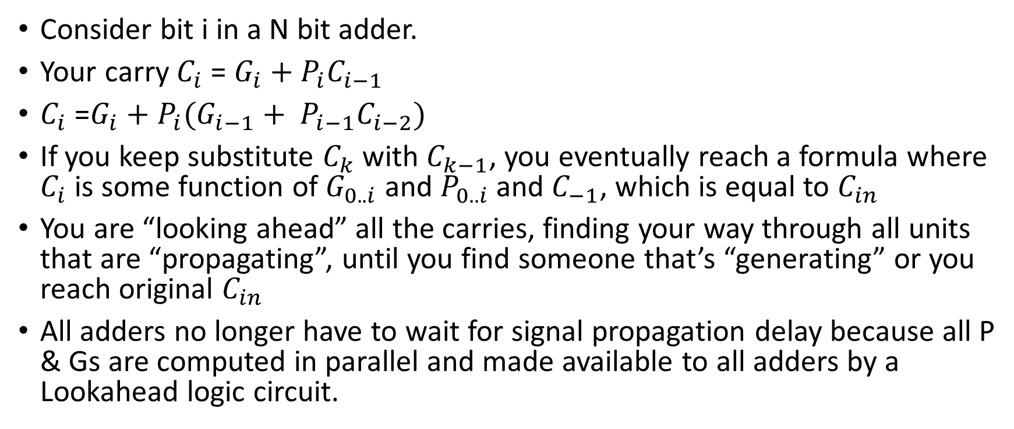
Recursive formula for carry
Consider bit i in a N bit adder.
Your carry $C_{i}$ = ${G_{i}+P_{i}C}_{i−1}$
$C_{i}$ =$G_{i}+P_{i}(G_{i−1}+ P_{i−1}C_{i−2})$
If you keep substitute $C_{k}$ with $C_{k−1}$, you eventually reach a formula where $C_{i}$ is some function of $G_{0..i}$ and $P_{0..i}$ and $C_{−1}$, which is equal to $C_{in}$
You are “looking ahead” all the carries, finding your way through all units that are “propagating”, until you find someone that’s “generating” or you reach original $C_{in}$
All adders no longer have to wait for signal propagation delay because all P & Gs are computed in parallel and made available to all adders by a Lookahead logic circuit.

Slide 15
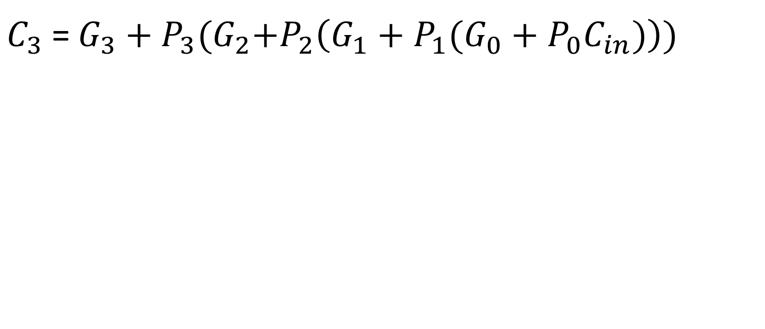
Example
$C_{3}$ =${ G}_{3} + P_{3}{(G}_{2}+P_{2}\left(G_{1}+P_{1}(G_{0}+P_{0}C_{in})\right))$

Slide 16
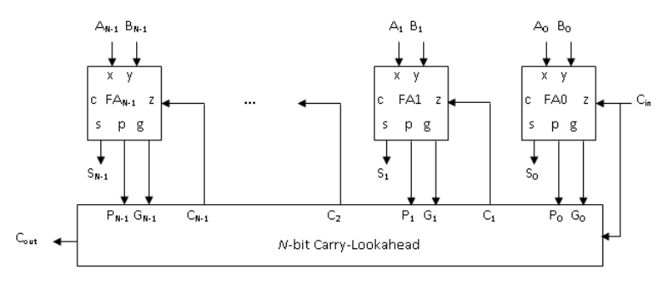

Slide 17
Assume all combinational logic (Propagate, Generate, Sum and Carry) take same amount of time dt (for simplicity, not in reality!)
Every dt, new produced values are marked red, done adders are marked with green circle

Slide 18
T=0
0
1
0
1
0
0
1
1
0
0
Carry Lookahead Unit

Slide 19
T=1
0
1
0
1
0
0
1
1
1
0
0
0
Propagate
Propagate
1
0
0
P=0
G=0
P=1
G=0
P=1
G=0
P=0
G=1

Slide 20
T=2
0
1
0
1
0
0
1
1
1
1
0
0
0
0
Propagate
1
Propagate
1
1
1
0
0
0
0
P=0
G=0
P=1
G=0
P=1
G=0
P=0
G=1

Slide 21
T=3
0
1
0
1
0
0
1
1
1
1
1
0
0
0
0
0
Propagate
1
Propagate
1
1
1
0
0
0
0
P=0
G=0
P=1
G=0
P=1
G=0
P=0
G=1

Slide 22
T=4
0
1
0
1
0
0
1
1
0
1
1
1
1
0
0
0
0
0
Propagate
1
Propagate
1
1
1
0
0
0
0
P=0
G=0
P=1
G=0
P=1
G=0
P=0
G=1

Slide 23
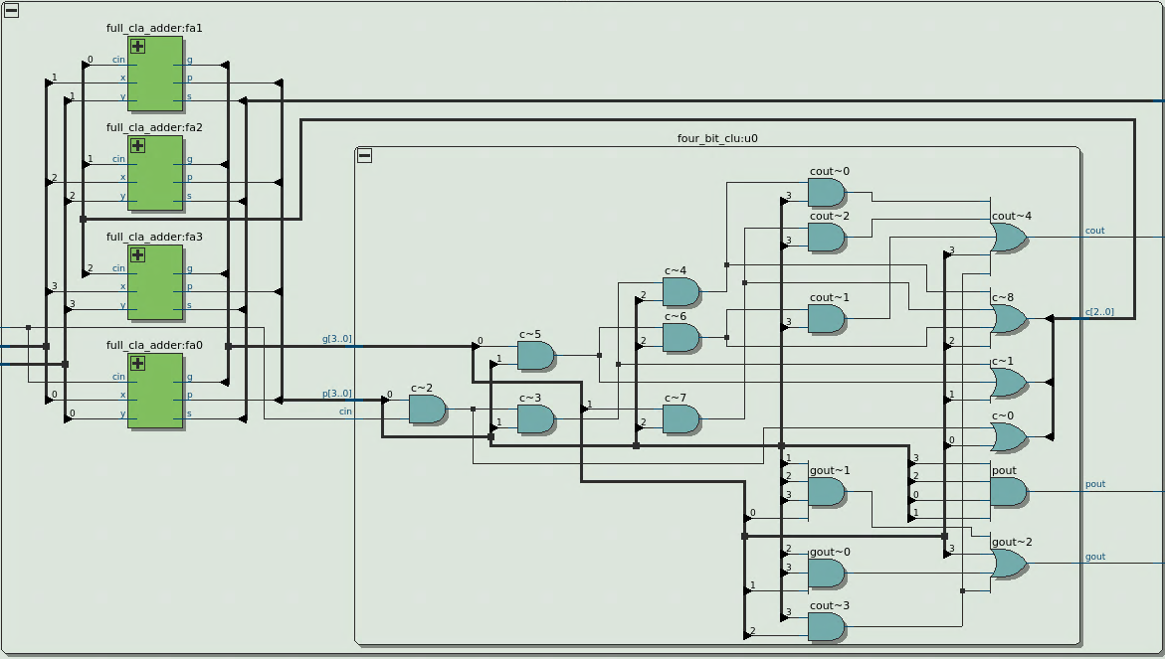
4-bit Carry Lookahead Unit at a glance
To achieve better performance, we often need to sacrifice area and energy. This is an engineering trade-off

Slide 24
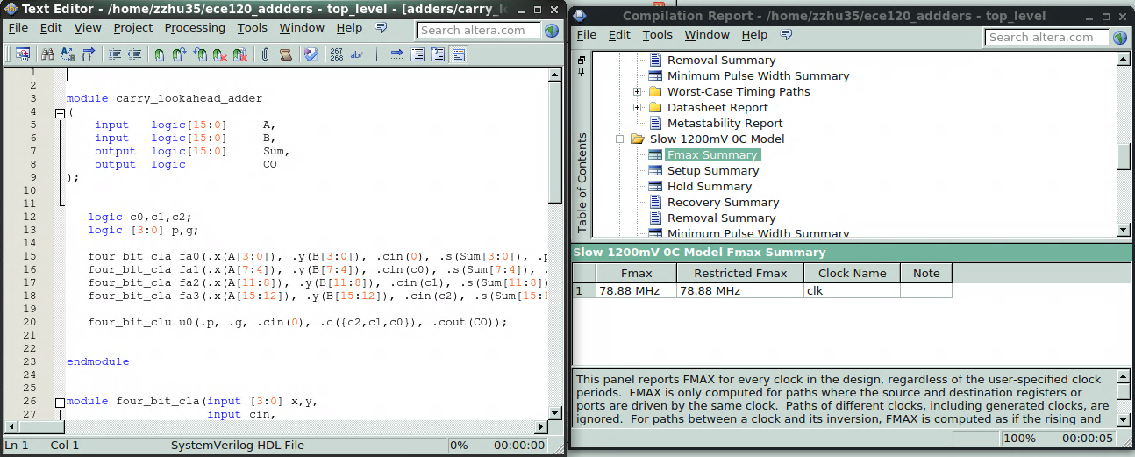

Slide 25
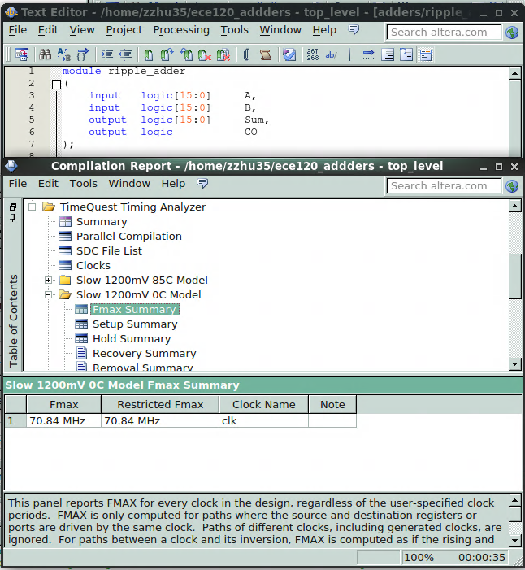

Slide 26
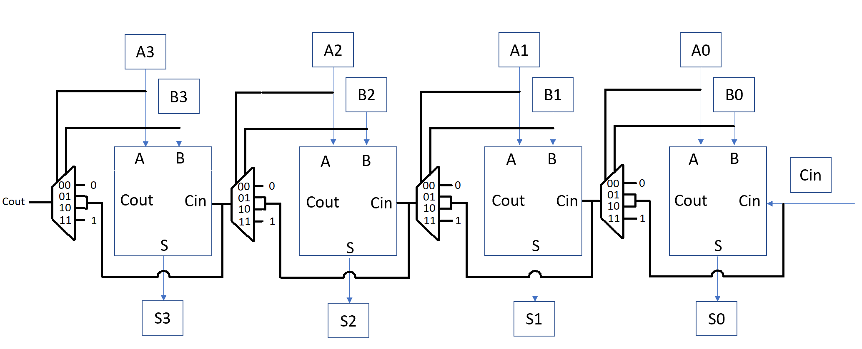
Implementation of CLA
Assuming Mux does not have any delays

Slide 27
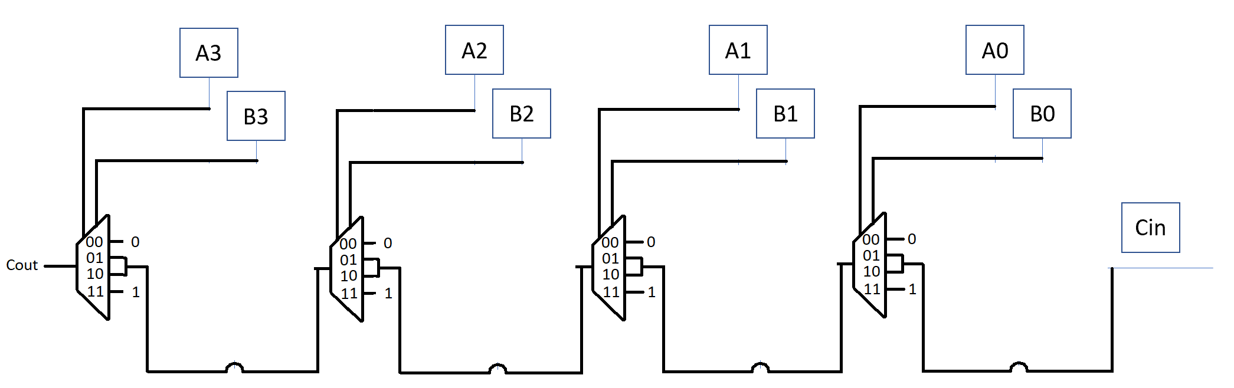
Implementation of CLA
Essentially a Fan-in series of 4 4-input Mux

Slide 28
What if Mux has delay?
This implementation still causes propagation trouble

Slide 29
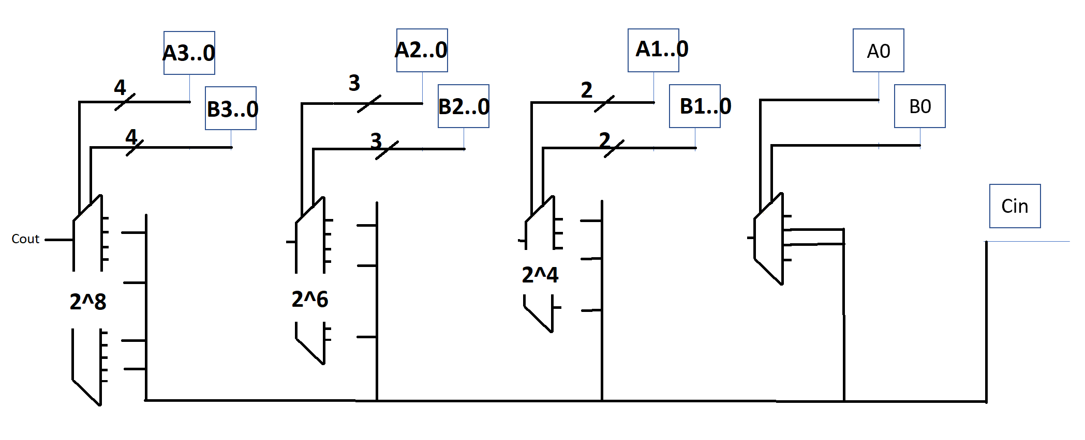
Solution
This circuit behaves exactly same as the “Carrylookahead Unit”. However, no hardware engineer will code 2^8 input mux. In fact, a lot of inputs in those big muxes are duplicates and/or don’t-cares. We can simplify the carry-MUX function into much more concise circuits with P&G signals using the recursive formula.
Combine fan in series into a big mux

